Slide 1
Chapter 7
Revenue & Yield Management

Slide 2
Objectives
After studying this topic you should be able to:
Understand the concepts of yield/revenue management;
Appreciate the characteristics needed for successful revenue management within organisations;
Develop knowledge of revenue management calculations and processes; and
Identify revenue management limitations in different environments, including profit maximisation issues.

Slide 3
Yield Management
Focuses on maximising the revenue yield from the combination of selling price and volume of activity. It could be seen as tactical, rather than strategic and had a narrow focus – for example selling a plane seat, event ticket, or a hotel room, but not considering ‘secondary’ spend in other areas

Slide 4
Revenue Management
Revenue management is seen as a development of yield management, it looks at ‘the bigger picture’, considering the fuller implications from a strategic perspective, so has a broader focus.

Slide 5
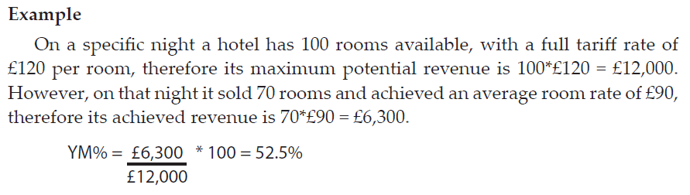
Yield management (YM) formula
YM% = Achieved Revenue * 100
Potential revenue

Slide 6
Characteristics required for revenue management (pt 1)
Product/Service is perishable
Relatively fixed capacity
Fluctuating demand
Suitable cost structure

Slide 7
Characteristics required for revenue management (pt 2)
Duration control
Advanced sales are common
Ability to segment the market
Overbooking policy

Slide 8
Drivers for Revenue Management
 | Few Prices | Many Prices
Controlled Duration | QUADRANT 1 Conference Centres Cinemas Spas Stadiums Venue Hire | QUADRANT 2 Airlines Hotels Cruise Liners Car Rental
Uncontrolled Duration | QUADRANT 3 Golf Courses Restaurants | QUADRANT 4 Private Hospitals Private Care Homes
(Adapted from Kimes & Chase 1998

Slide 9
Summary
Revenue management is about selling the right product to the right customer for the right price at the right time.
The yield management formula can be used to combine the impact of volume of sales and selling price in one measure.
Revenue management is not suited to every situation and works best when certain characteristics are present.
Products and service can be adapted to make them more conducive to using revenue management.
Concern needs to be given to ensuring revenue maximisation is not at the cost of profit maximisation.

